Slide 1


TRANSLATING PROFESSIONAL
TERMINOLOGY AND TEXTS
Meta Arnež
Šolski center Kranj
Srednja tehniška šola

Slide 2

What does it take?
It takes to be an expert in both:
  professional field of the text
  language connoisseur.
A good translator must know:
  basic concepts of the profession
  professional terminology
  the phenomena of the professional field
  the style in which a text is written

Slide 3
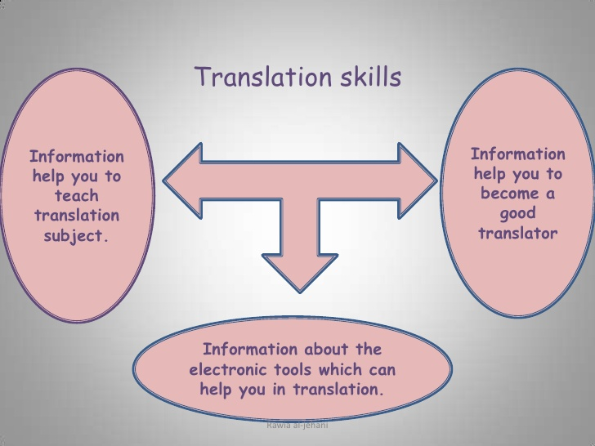

Slide 4
I want to be a translator when I grow up!
No school can adequately “make” a good translator
Translator’s own effort to become expert
Get to know the field of expertise
Professional investigation into field of expertise

Slide 5
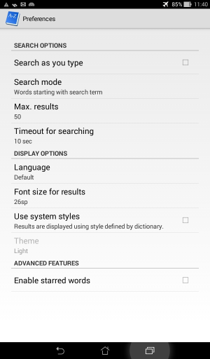
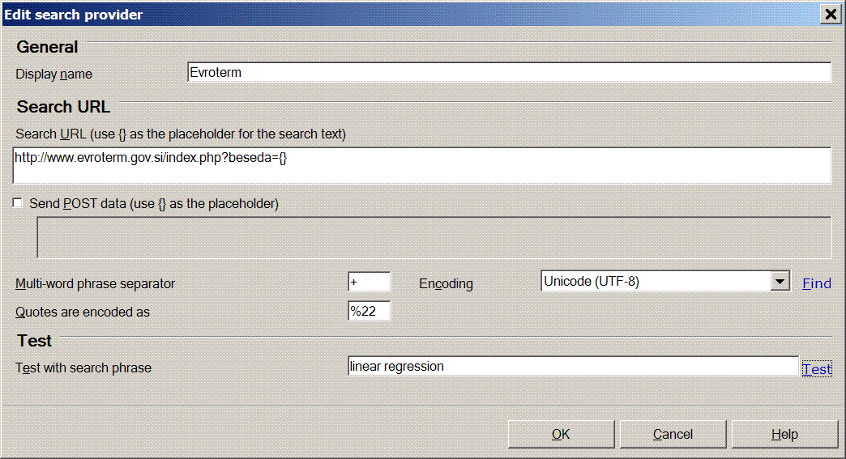
Translation corpuses
(or: Where can I find this word??)
Evroterm
Eurlex
Evrokorpus
PONS
Trojezični strojniški slovar

Slide 6


